Slide 1
The Very Busy Spider – Eric Carle

Slide 2
TOPIC BOARD
YES
NO

Slide 3
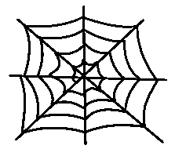

Slide 4
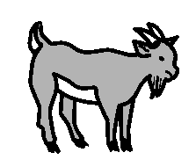

Slide 5
